Slide 1


YOUR TRUE FRIEND
PREVENT STUDENT’S HEALTH
TECH BUSTERS
1.GAGANDEEP KUMAR
2.MANAS SAHNI
3.MANAN SRIVASTAVA
4.NAMAN MAHENDRA
EDUTHON-EDUCATION THEMED HACKATHON
01

Slide 2
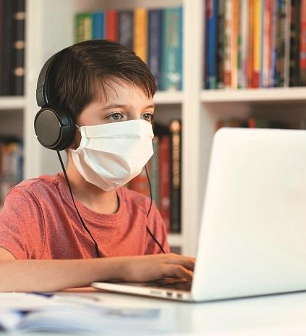
PROBLEM STATEMENT
In this lockdown due to corona virus many things have changed and the biggest change that we can see is in education field. Due to lockdown schools, colleges ,coaching institutions are closed and they are forced to conduct online classes.
These online classes is having a very bad effect on student’s health . In these classes students have to see in their laptop or pc for long time due to which their eyes are getting damaged and vision is degrading. They have to wear headphones while attending classes due to which students are facing ear related problems. Many institutions are running very long classes and students have to sit at one place and attend the classes for long time . This have caused posture related problems in many students . And the biggest side effect of these classes can be ssen on the students mental health. These classes are having very bad effects on the student’s mentsl health.

Slide 3

PROPOSED SOLUTION
To overcome the problem of effects of Online Classes we have make a website “Your True Friend” . Our website "Your True Friend" is a complete solution for students to help them get out of the problems and loneliness they are facing in this harsh time of Covid Outbreak . We are ready to help students reaching us in every possible way. We help students in the following ways :
Giving them crucial tips on managing Online Classes and Self Study at home.
2. Giving access to a number of Workout tutorials and maintaining BMI via BMI Calculator to help students staying at home maintaining their Physical Fitness.
3. Tips and Solutions to reduce the problem of Eye Strain in order to maintain a good eyesight which is very important since students have attend Online Classes constantly for hours . In such a scenario it becomes important to take care of eyes which are a one of the most crucial parts of the body.
4. Solutions to help students at home to overcome anxiety and loneliness in Covid time.
5. Also helping the students in overcoming the Fear of Covid.

Slide 4
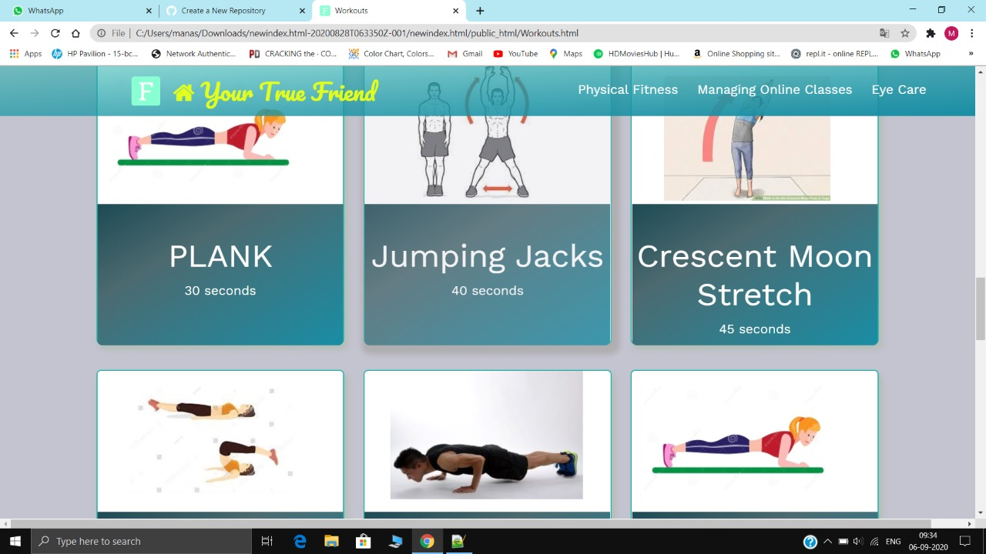
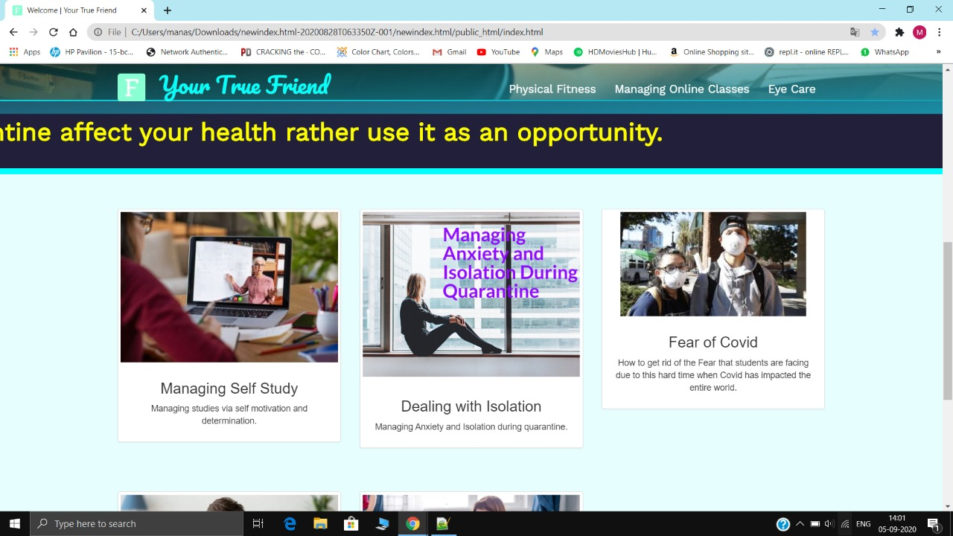
SOME IMAGES OF PROJECT

Slide 5

YOUR TECH STACK
1.
HTML
Hypertext Markup Language, a standardized system for tagging text files to achieve font, colour, graphic, and hyperlink effects on World Wide Web pages.
2.
CSS
Cascading Style Sheets is a style sheet language used for describing the presentation of a document written in a markup language like HTML
3.
JAVA SCRIPT
JavaScript is a scripting or programming language that allows you to implement complex features on web pages — every time a web page does more than just sit there and display static information for you to look.
3.
BOOTSTAP
Bootstrap is a free and open-source CSS framework directed at responsive, mobile-first front-end web development. It contains CSS- and (optionally) JavaScript-based design templates

Slide 6

THANK YOU

